Slide 1

Top 7 OLLI Brand Guidelines

Slide 2
Why follow these 7 Brand Guidelines?
Consistency is the hallmark of building a strong recognizable brand
These OLLI guidelines align with and are a subset of the UGA brand guidelines

Slide 3
Top 7 Brand Guidelines (1 of 4)
Logo: Maintain existing look & feel (sorry, no changing of colors, no stretching, etc.)
Templates: Templates for PowerPoint and Word documents can be found at https://olli.uga.edu/olli_members/organization_information/olli_organization_information.php . Contact Tim Meehan for others

Slide 4
Top 7 Brand Guidelines (2 of 4)
Font: If you don’t have access to the official Gothic & Merriweather fonts, use Tahoma or Georgia (both free and most likely already on your computer) Try to keep minimum copy size font to 12 pt
Writing Style: Copy should communicate confidence, respectfulness, earnestness but not humorless. Directness with touch of inspiration. (we use the AP style book)
Imagery: Use photography, with action shots of a diverse group of individuals. Request access to the Photo Gallery folders from Tim Meehan (Timothy.Meehan@UGA.edu)

Slide 5
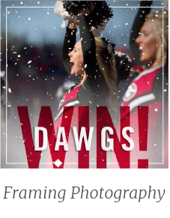



Top 7 Brand Guidelines (3 of 3)
Borders: When a border is called for, use a single line with a width between .5 pt – 2 pt
There are 3 ways to use a border – examples to right

Slide 6
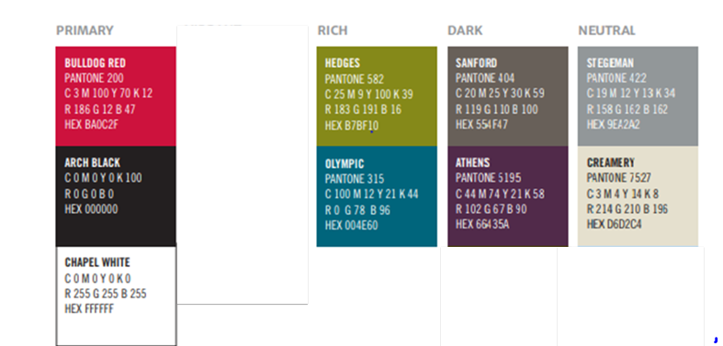
Top 7 Brand Guidelines (3 of 3)
Colors: Lean heavily on the primary palette, but use the supporting secondary colors to build color schemes that are complementary and balanced.
These 6 colors are the OLLI
secondary colors

Slide 7
Top 7 Brand Guidelines
The Marketing & Communications team is available to do a final review of your document to ensure brand standards are met.
Contact Timothy.Meehan@UGA.edu or Patricia.Dixen@yahoo.com to request the review

